Slide 1
Part-1
POPULATION AND DEVELOPMENT

Slide 2
Population growth
Population growth is the net change in population within a specific period in a given area.
Population growth can be measured in a neighbourhood, country, or even global level!
Population growth can be positive, can well be negative! It depends on the nett change in population over a specific time frame.
The three leading causes of population growth are births, deaths, and migration. Births and deaths are seen as natural causes of population change.
Components of population growth
Natural increase/decrease: Birth rate, death rate, infant mortality rate, life expectancy
Net migration: Immigration, emigration, net migration rate
Childbearing patterns: Total fertility rate, replacement level fertility
Patterns related to death: Crude death rate, age-specific death rate
Age structure (distribution of age groups): Dependency ratio, median age

Slide 3
Population growth and economic growth
Population growth and economic growth are closely related to one another. For example, productivity is an important factor in economic growth.
How might productivity be important to population growth?
A greater population means that there is a larger workforce. A larger workforce means that there is potential for higher productivity to produce more goods — this results in greater output (GDP)! Not only is there a greater supply of workers, but there is also a greater demand for goods and services as well. Greater demand and supply will lead to an increase in overall economic growth.
More people in a country will also result in higher tax revenues for the government. The government can use the increased tax revenue to build infrastructure or improve welfare programs. Lastly, a higher population increases the probability of innovation in the free market.
In brief, positive economic effects are: more people means more output, more tax revenue and innovation in market.

Slide 4
Population growth and economic growth: The darker side
Greater population growth may exacerbate the problem of resource scarcity.
If a country is barely providing resources to its current population, people will not be able to access resources since there will be too many people demanding too few resources.
Population growth can also put pressure on certain areas where people migrate to, such as cities. Cities tend to have more people living in them as opposed to rural areas; as such, cities can become overburdened with too many people living in them.
Traffic congestion and pollution are often problems in these areas.
Traffic congestion erodes productive time ……..results in fuel inefficiency….. Contributes to air pollution, thereby increasing externality.
Population growth not only can adversely affect economic growth, can also contribute to environmental degradation.
What can be a nexus between population growth and agriculture?
Discussion time

Slide 5
Historical population growth at global scale
Sources: Clark, 1967; UNDP, 1974; FAO, 1980

Slide 6
Since mid-November 2022, global population has crossed 8 billion!
It was 6 billion in 1998.
It was 7 billion in 2010.
The population grew more than thrice in about 72 years!!
The growth rate appears faster in recent decades.
What actually happened?

Slide 7
Can we explain what happened to global population growth?
Components of population growth
Natural increase/decrease: Birth rate, death rate, infant mortality rate, life expectancy
Net migration: Immigration, emigration, net migration rate
Childbearing patterns: Total fertility rate, replacement level fertility
Patterns related to death: Crude death rate, age-specific death rate
Age structure (distribution of age groups): Dependency ratio, median age
What are the underlying causes of the rapid increase in global population since the Industrial Revolution?
Can we explain the implications of rapid population growth?

Slide 8
Effects of population growth on economic development & environment
Early days of PG: Access to resources (labour mobilization), value addition (commodities, industrial products) and economic growth.
Higher birth rate plus immigration have led to population growth.
Industrial revolution.
Consequence: Large-scale labour migration, leading to urbanization.
Urbanization
The Romans founded London about 50 AD. The Bank of England was founded in 1694.
Paris was founded in 259 BC. It was a mere fishing village then for the Parisii, a Celtic tribe. The Romans conquered the Parisii in 52 AD. In 1528 King Francois I moved his court to Paris. King Henry IV began building great public buildings in Paris. The Palais Royal was built in 1629 by Cardinal Richelieu.
The French Revolution broke out in 1789.

Slide 9
Urbanization (Contd.)
The history of Berlin starts with its foundation in the 13th century. It became the capital of the Margraviate of Brandenburg in 1417.
In 1763, Frederick the Great (Prussia’s King) founded the Königliche Porzellan-Manufaktur Berlin (Royal Porcelain Manufacture).
New York City traces its origins to Fort Amsterdam and a trading post founded on the southern tip of Manhattan Island by Dutch colonists in approximately 1624.
In 1664, the English took control of the area and renamed it New York.
Between 1892 and 1954, millions of immigrants arrived in New York Harbor.
New York City was the first capital of the United States after the Constitution was ratified in 1788. On April 30, 1789, George Washington was inaugurated as the nation’s first president at Federal Hall, located on Wall Street.

Slide 10
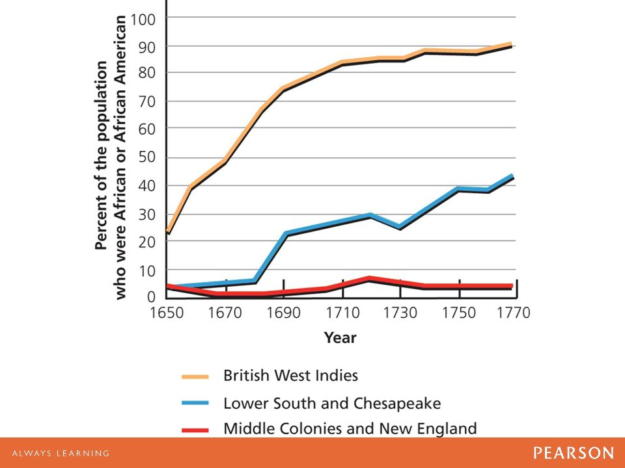
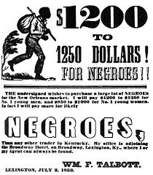
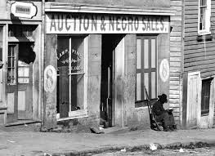
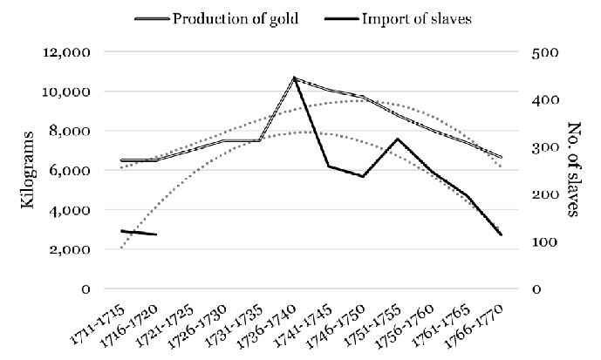
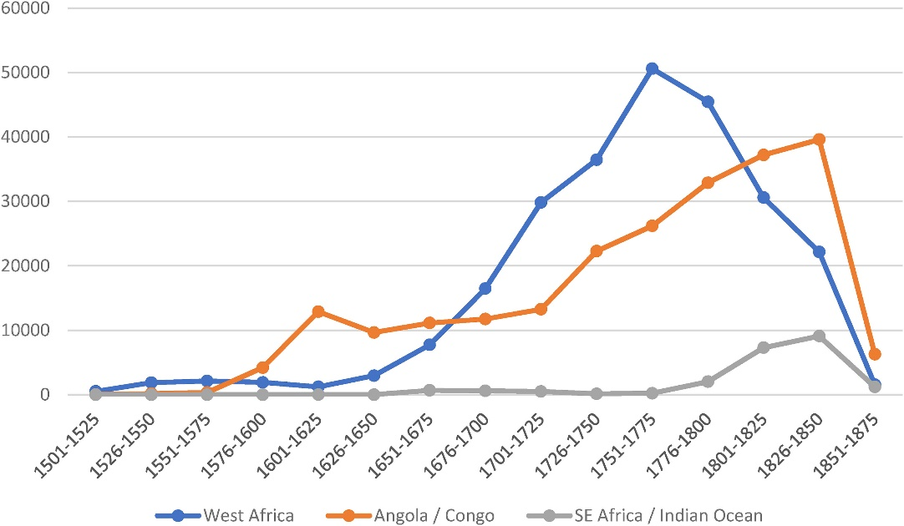

Slide 11


Slide 12
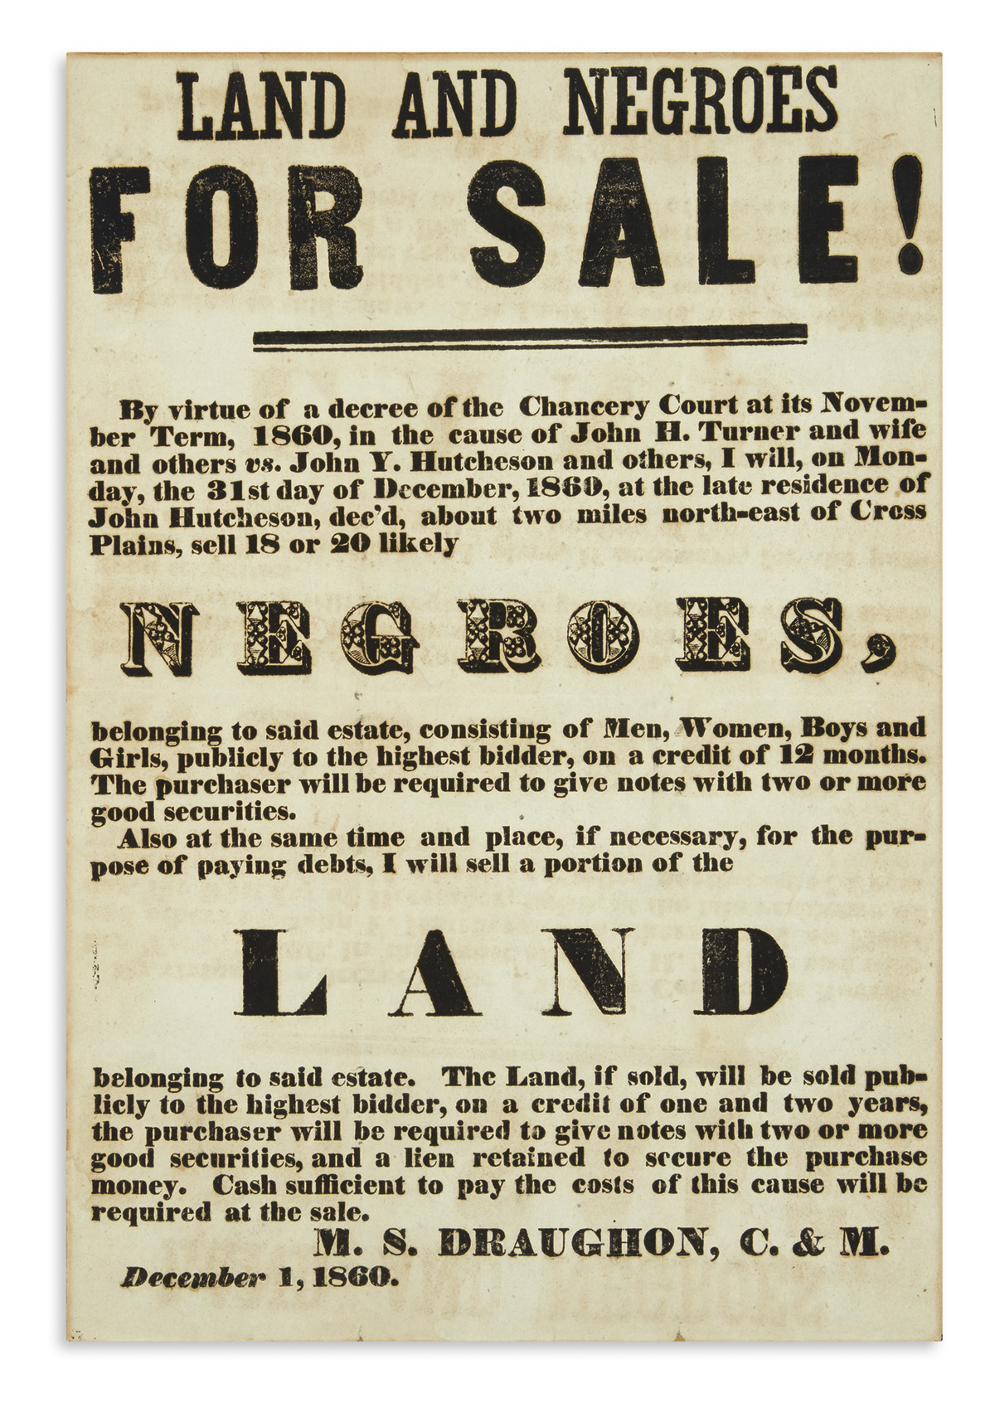
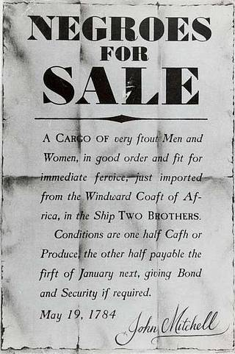

Slide 13
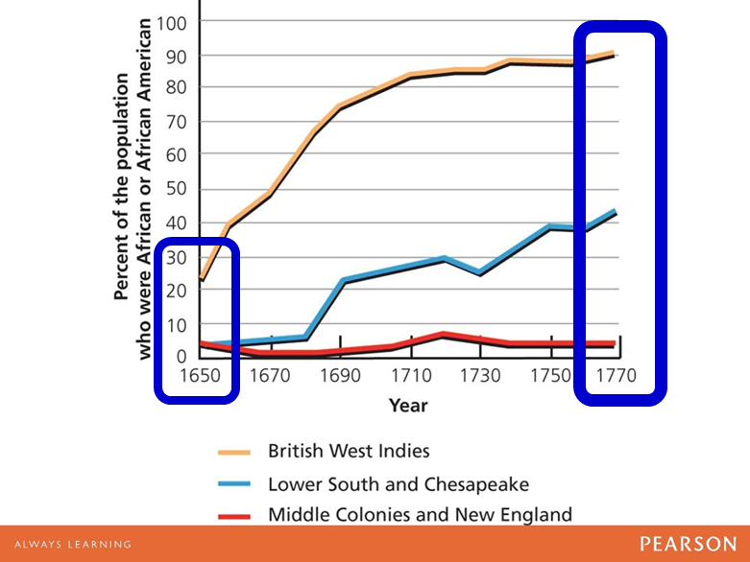

Slide 14


Slide 15
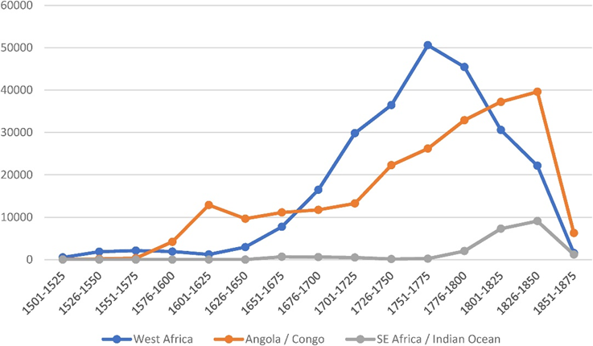

Slide 16
Effects of population growth on economic development & environment (Contd.)
Early days of PG: Access to resources (labour mobilization), value addition (commodities, industrial products) and economic growth.
Higher birth rate plus immigration have led to population growth.
Industrial revolution.
Consequence: Large-scale labour migration, leading to urbanization.
Innovation and technological advancements.
High population density and demand for food and services – colonization.
Further exploitation of resources, exacerbating economic growth.
Consumption behaviour – redefining “more”, looking beyond natural sources!
Behavioural change leading to unprecedented exploitations and externalities.

Slide 17
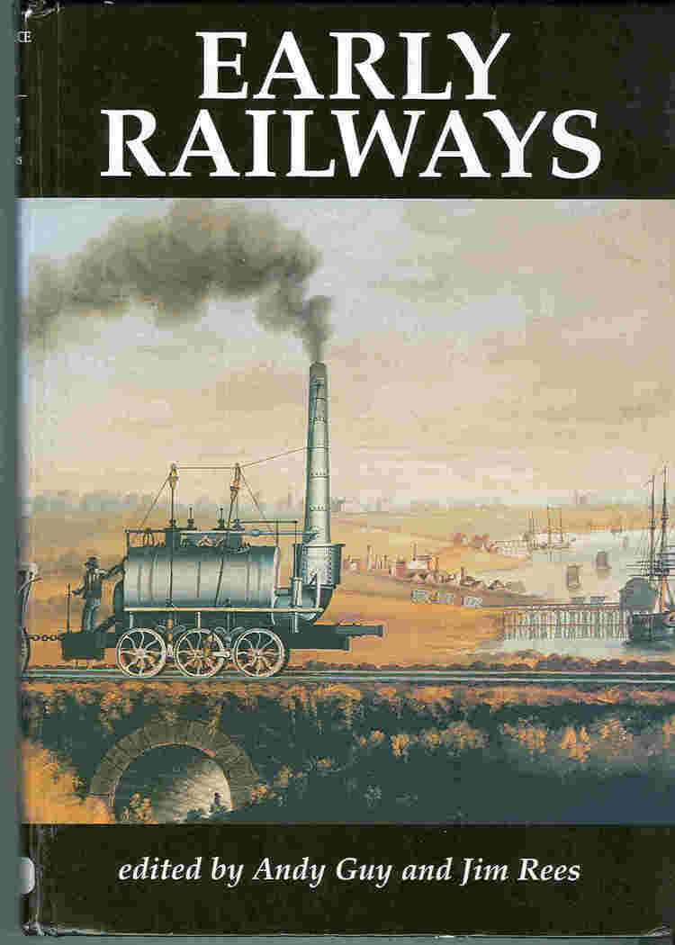
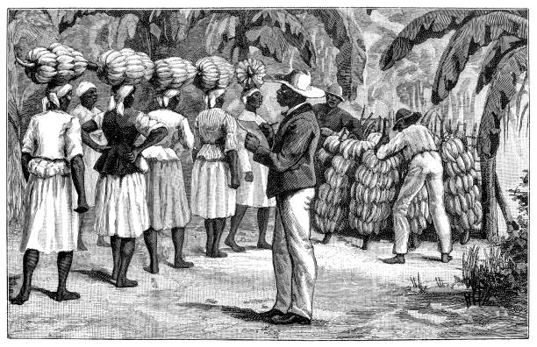
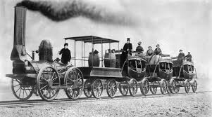
Technological innovation has allowed (industrial scale) mobilization of slaves, immigrants and labour, even transportation of labour from urban centres to workplaces.

Slide 18
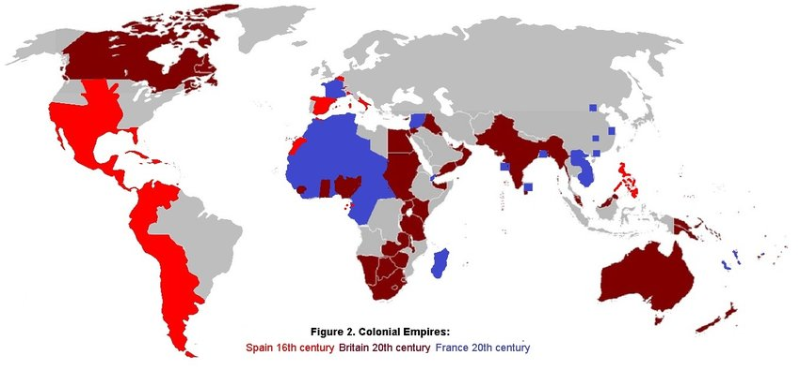
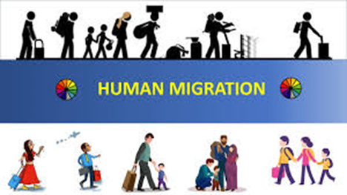

Slide 19
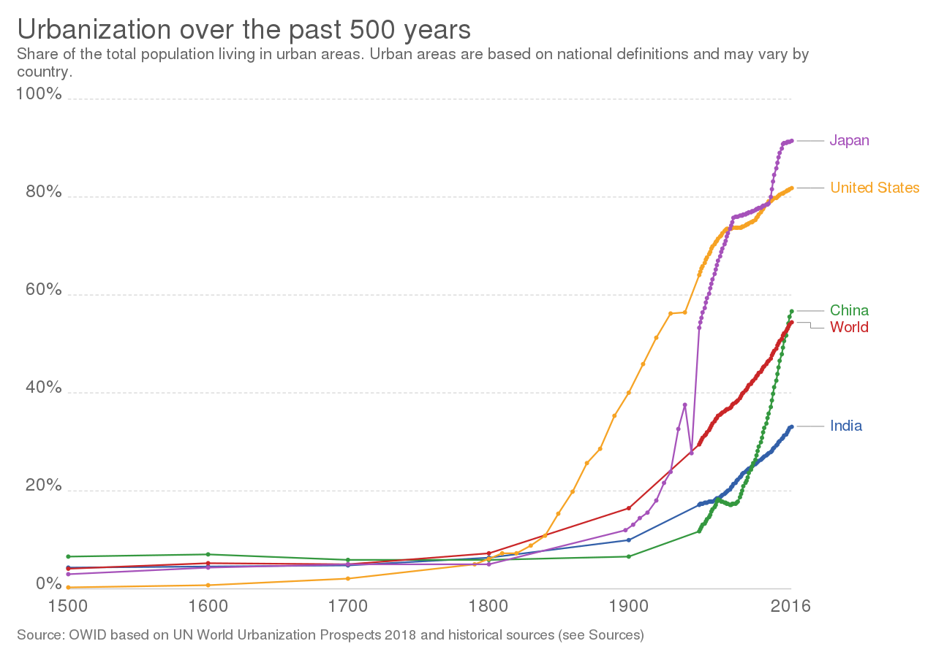
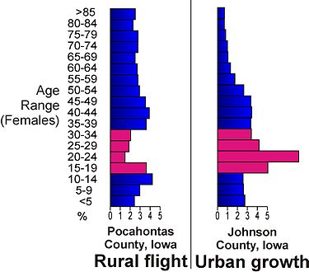

Slide 20
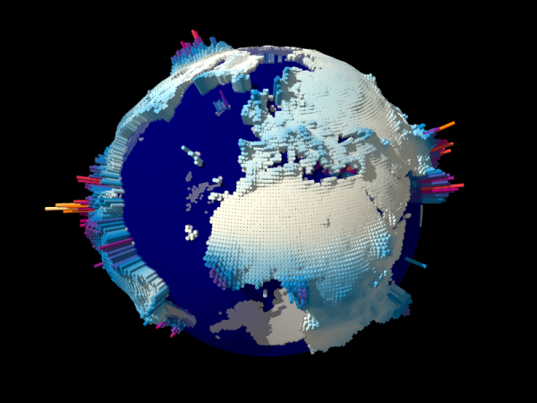
Rapid growth has led to uncontrolled urbanization, which has produced overcrowding, destitution, crime, pollution, and political turmoil.
Rapid growth has outstripped increases in food production, and population pressure has led to the overuse of arable land, forests, and destruction of these resources.
AFRICA

Slide 21
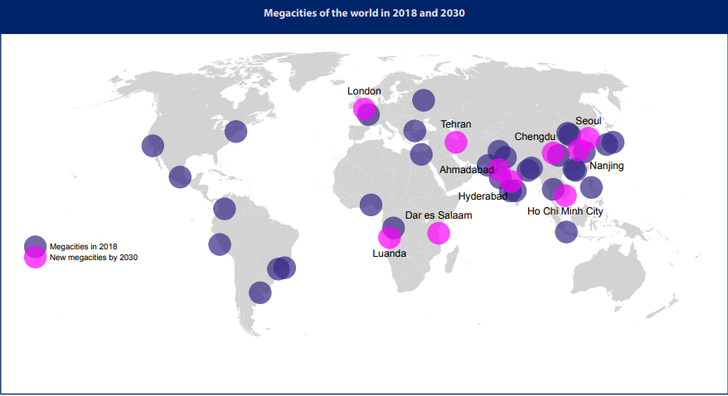
The rise in the number of megacities is the most visible evidence of the accelerating global trend towards urbanization. In 1950, cities were home to 751 million people, less than one-third of the global population. Just two (New York and Tokyo) had more than 10 million inhabitants. Today, 55% of us (i.e, 4.2 Bn) live in urban areas.

Slide 22
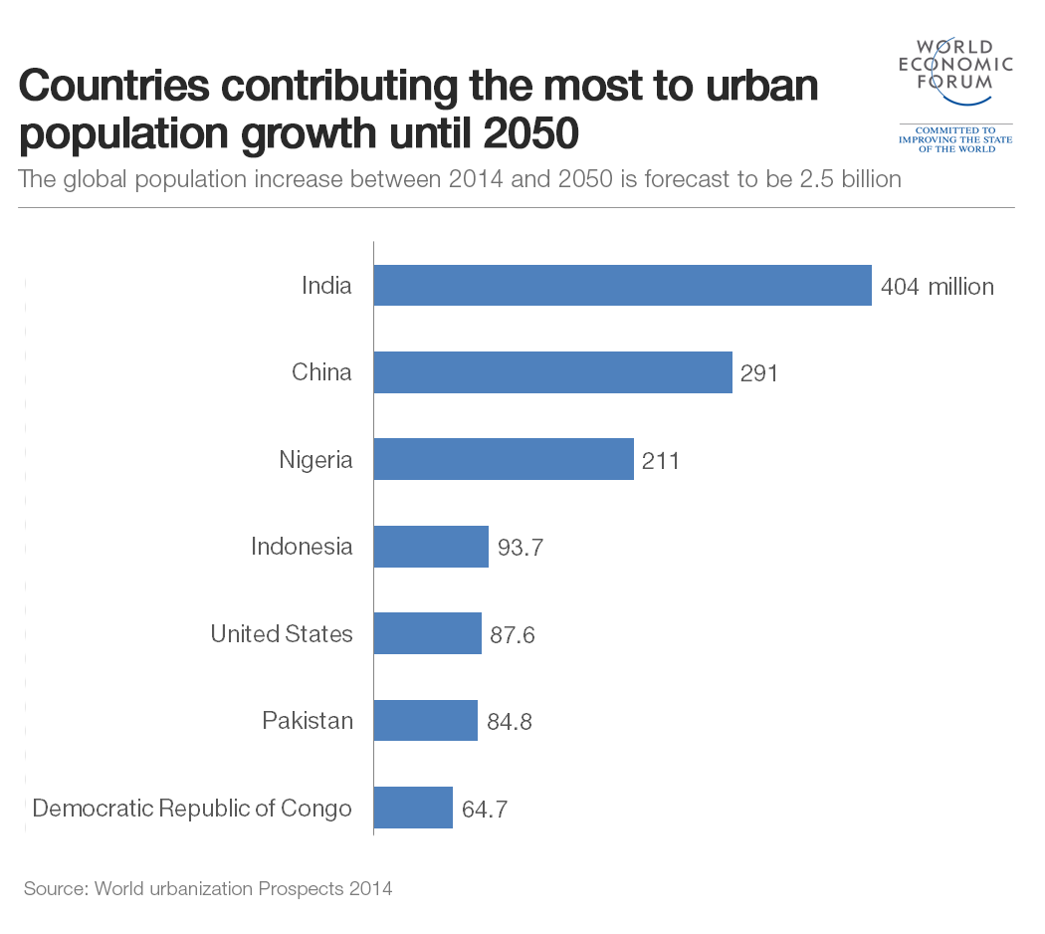
68% of global projected population will live in urban areas by 2050!
Five biggest challenges are likely to be confronted by future urban growth.
Environmental threats
Resources (water, food, energy)
Inequality
Technology (mobility)
Governance
Cities are growing much faster than the rate of integration of innovative solutions towards addressing the above-mentioned challenges.

Slide 23
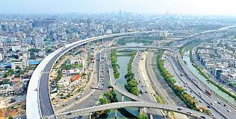
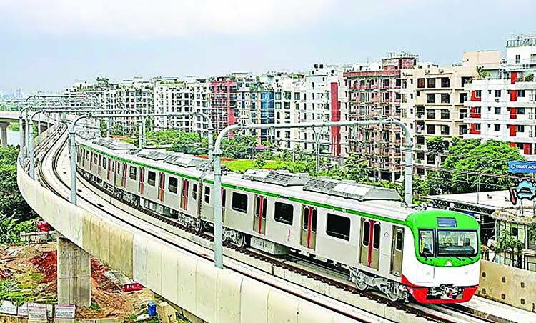
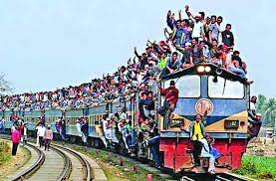
Urban development must occur at a rate faster than the needs of goods and services exerted by the population growth.
Are there examples of slowing down of rate of urbanization?

